Slide 1

TransparAI: Making AI Reasoning Transparent
TransparAI is an educational AI assistant that shows its reasoning process.
Instead of just giving answers, it displays step-by-step how it thinks through problems.
Built to help students and educators understand how AI actually works.
Built for the AWS AI Agent Global Hackathon (DEVPOST) 2025.
Created by
Sai Sudheer
sudheer628@yahoo.com
https://www.linkedin.com/in/sai-sudheer-kolagatla/

Slide 2

The Problem: AI's Black Box Challenge
AI today gives you answers but doesn't show how it got there. Students and teachers can't see the thinking process, making it hard to learn from AI or trust its responses.
The Opacity Crisis
Educational Gap
Users can't see how LLMs process information or make decisions, limiting understanding and trust
Traditional AI interfaces don't support learning about AI systems themselves
Visual Learners Left Behind
Text-only responses fail to leverage how most people actually learn best

Slide 3




Our Solution: Transparency Through Visualization
Real-Time Reasoning Visualization
Familiar ChatGPT-Style Interface
Watch as the AI breaks down problems, analyzes context, and builds responses step-by-step
Intuitive conversation flow enhanced with transparency layers that reveal the thinking process
Education-First Design
Purpose-built for learners who want to understand AI, not just use it

Slide 4





Architecture: Built on AWS Excellence
User Interface
React-based frontend with React Flow for interactive visualizations
AWS Lambda Functions
Serverless processing handling requests and orchestrating AI calls
AWS Bedrock + Nova Pro
Powerful LLM reasoning with structured output capabilities
Amazon RDS
Persistent storage for conversation history and learning analytics
Our architecture leverages AWS's robust ecosystem to deliver seamless, scalable AI transparency. Every component works together to transform opaque AI responses into clear, educational experiences.

Slide 5
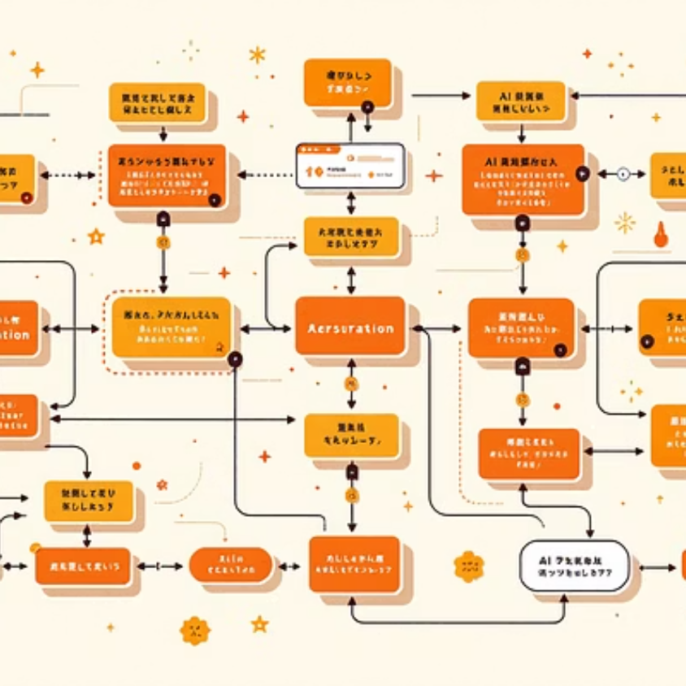



Key Features in Action
01
02
Ask Any Question
Watch AI Think
Students engage naturally through conversation
Reasoning nodes appear in real-time, showing the breakdown
03
04
Explore Connections
Learn Deeply
Interactive flow diagrams reveal how ideas connect
Understanding grows through visual exploration

Slide 6
Technology Stack: Modern & Powerful
Backend Power
Frontend Innovation
AWS Bedrock
React + TypeScript
Foundation model access with Nova Pro for advanced reasoning capabilities and structured outputs
Type-safe, component-based architecture for maintainable code
AWS Lambda
React Flow
Serverless compute enabling instant scaling and cost-effective operation
Beautiful, interactive node-based visualizations that make reasoning tangible
Amazon RDS
Modern Tooling
Reliable PostgreSQL database for conversation persistence and analytics (note: I am unable to demonstrate it as I have faced some challenges with Action Group)
Vite, TailwindCSS, and GitHub Actions for rapid development

Slide 7
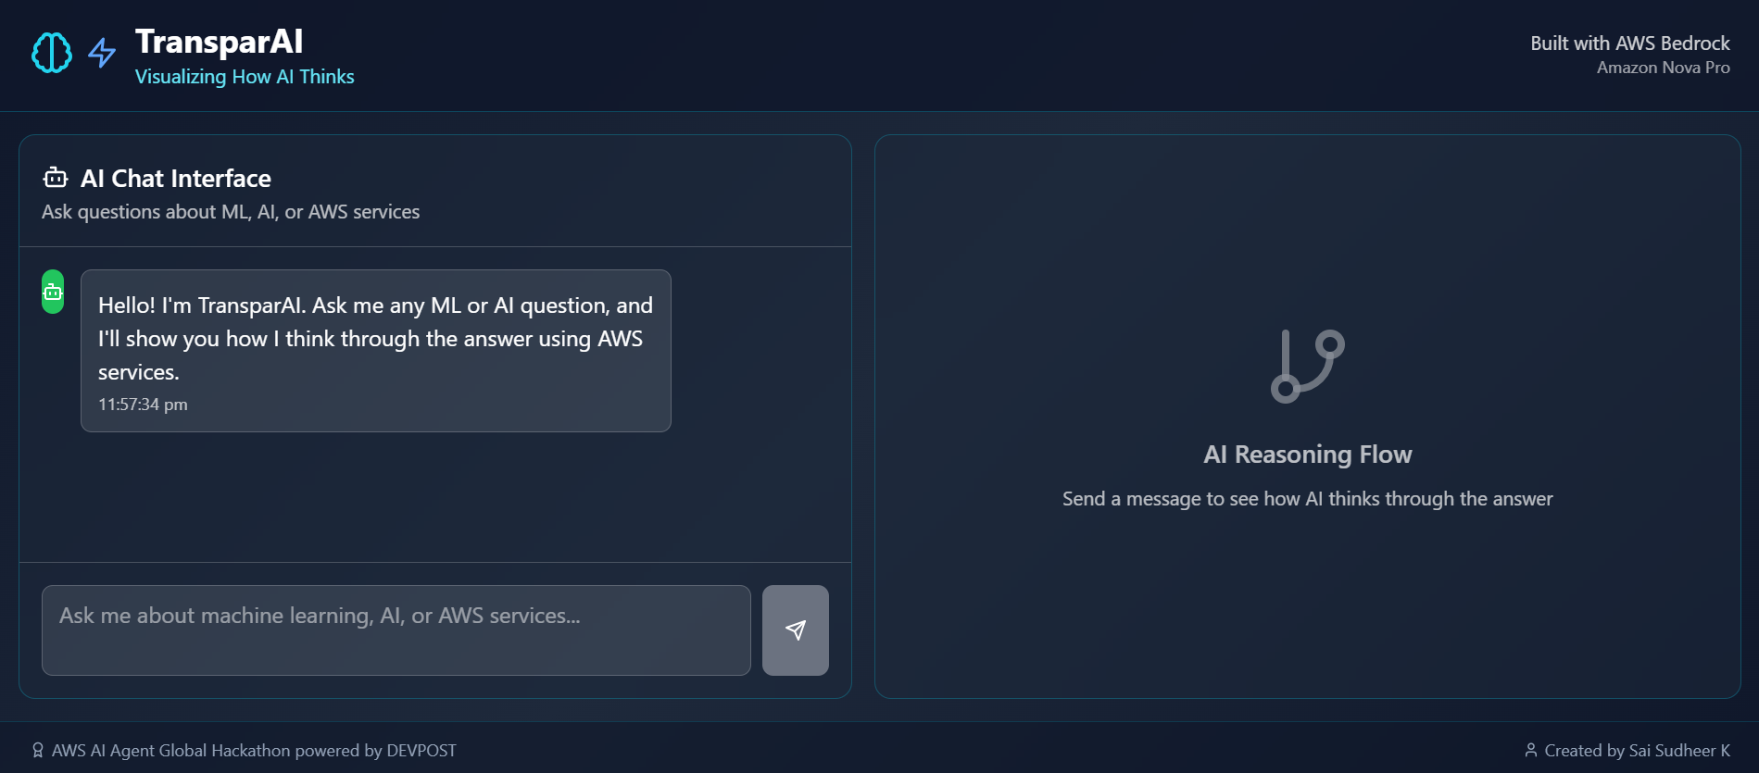
Questions to Try:
"Explain how photosynthesis works"—watch the AI break down biological processes
"What are the steps to solve a quadratic equation?"—see mathematical reasoning unfold

Slide 8
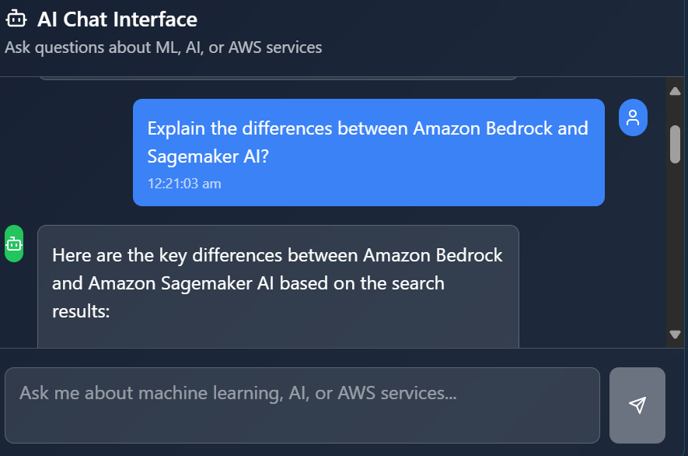
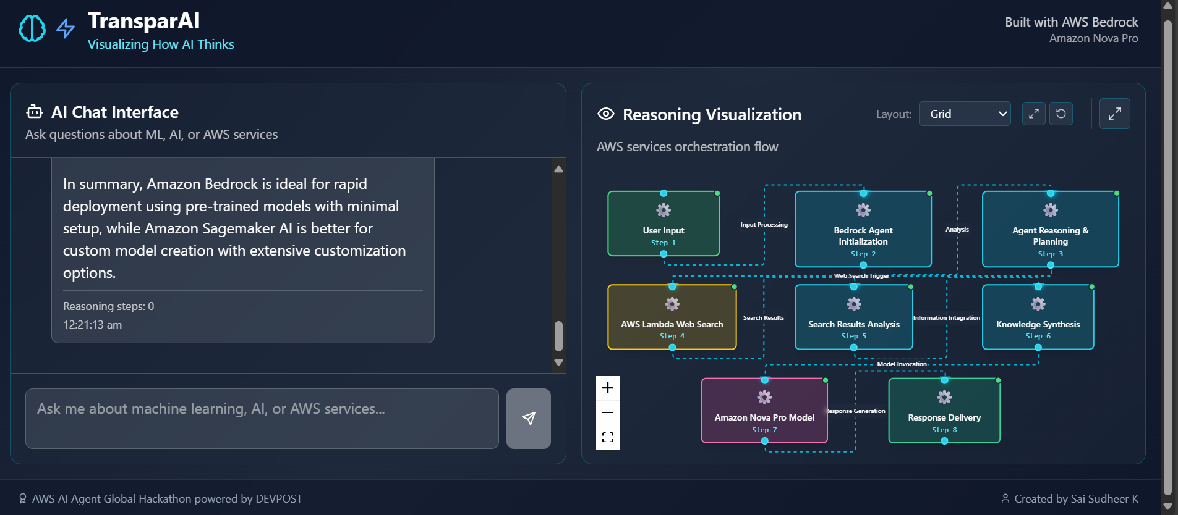

Slide 9
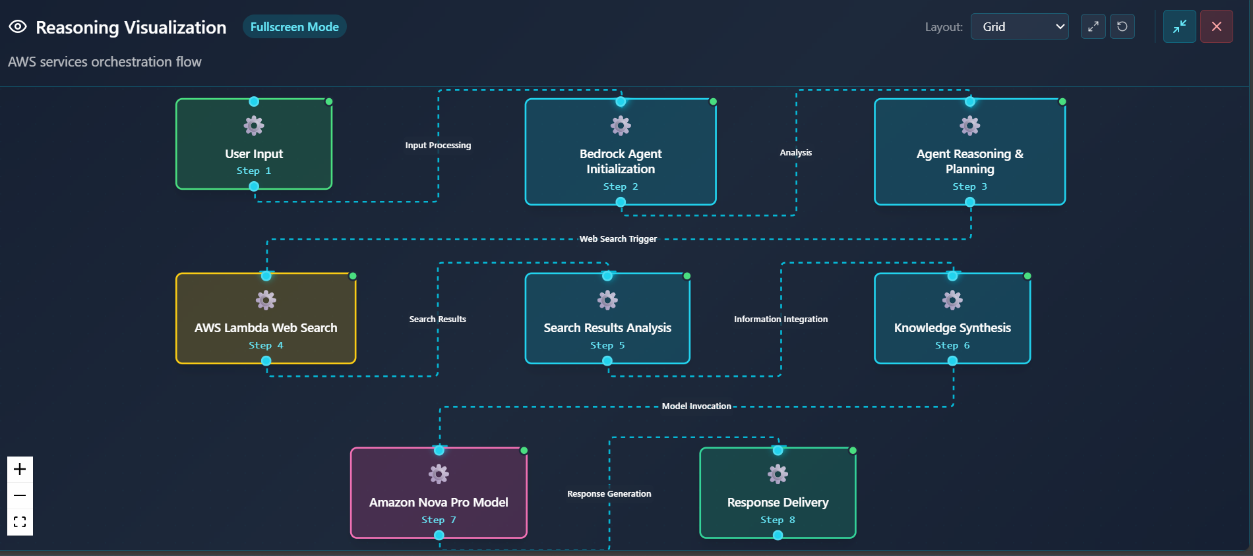
Reasoning Flow:

Slide 10
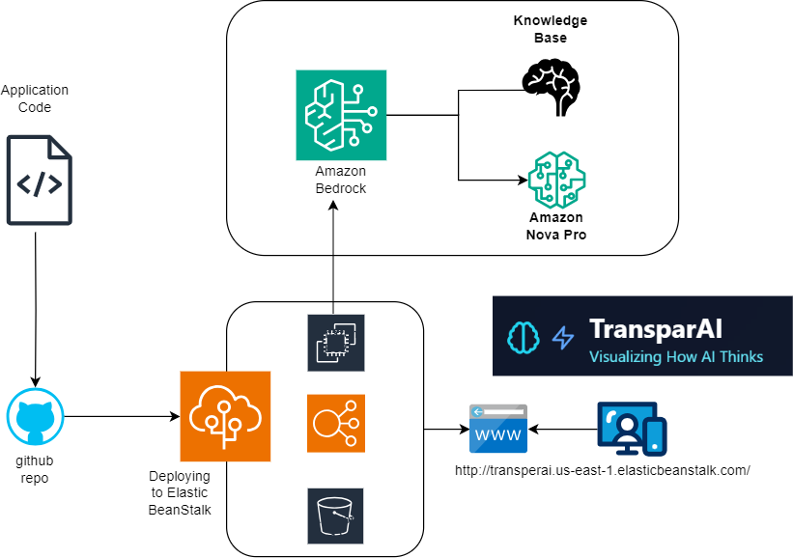
Architecture

Slide 11

A Heartfelt Thank You
“Big shoutout to DEVPOST for hosting this hackathon”
🚀 Connect With Me
GitHub: github.com/sudheer628
https://www.linkedin.com/in/sai-sudheer-kolagatla/

